Slide 1

B.Tech External Project Evaluation, VIIIth Sem
Energy Conservation with Modern Technology using IoT
Presented by :
Nikita Sinha (2019610336)
Pallavi( 2019003306)
Under the Supervision of:-
Dr. Subrata Sahana
DEPARTMENT OF COMPUTER SCIENCE & ENGINEERING
SHARDA SCHOOL OF ENGINEERING AND TECHNOLOGY
MAY 2023
1

Slide 2
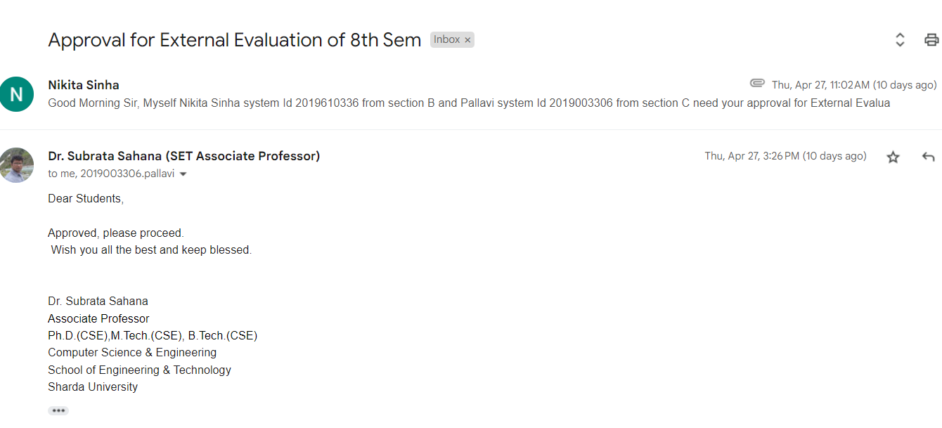
APPROVAL FROM GUIDE FOR THE EVALUATION

Slide 3



CONTENTS OF THE PRESENTATION
Introduction
Motivation
Problem Statement
Objectives
System Design
Results
Conclusion
Reference

Slide 4
INTRODUCTION
Energy conservation is the practice of reducing the amount of energy used without sacrificing the quality of life or comfort.
It is an important aspect of sustainability, as it helps to reduce the negative environmental impact of energy production and consumption.
Energy conservation can be achieved through various methods, such as using energy-efficient appliances, improving insulation, and reducing unnecessary energy use.
It can also involve adopting renewable energy sources, such as solar or wind power, to reduce reliance on non-renewable resources.
The benefits of energy conservation include cost savings, reduced carbon emissions, and improved air and water quality.

Slide 5
MOTIVATION
Energy conservation can lead to significant cost savings for individuals, businesses, and governments.
Energy conservation helps to reduce our dependence on non-renewable sources of energy, such as oil and gas, which are finite resources.
To ensure that future generations have access to the same resources and opportunities as the current generation.
Energy conservation reduces the demand for energy production, which in turn reduces the negative impact of energy production on the environment.

Slide 6
PROBLEM STATEMENT
Lack of awareness: one of the primary challenges with energy conservation is a lack of awareness or understanding of its importance.
Upfront costs: another challenge is the upfront costs associated with energy-efficient appliances or systems..
Inefficient infrastructure: the existing infrastructure for energy production, distribution, and consumption may be inefficient and not designed for optimal energy conservation.
Lack of incentives: finally, there may be a lack of incentives or policies in place to encourage energy conservation.

Slide 7
OBJECTIVE
ENERGY EFFICIENT SERVICE PROVIDING
We aim to study about a middleware for IoT tech stack, which can recognize different services and features and categorize them via a ranking solution similar to the page ranking algorithm.
ENERGY EFFICIENT RESOURCE UTILIZATION
Aims to study about a trade-off between energy consumption and desired climate setting in greenhouse i.e. Temperature CO2 level, and humidity.
ENERGY EFFICIENT NETWORKING
Our motive is to study how to optimize the power consumption of sensor nodes to enhance the life time of the network.

Slide 8
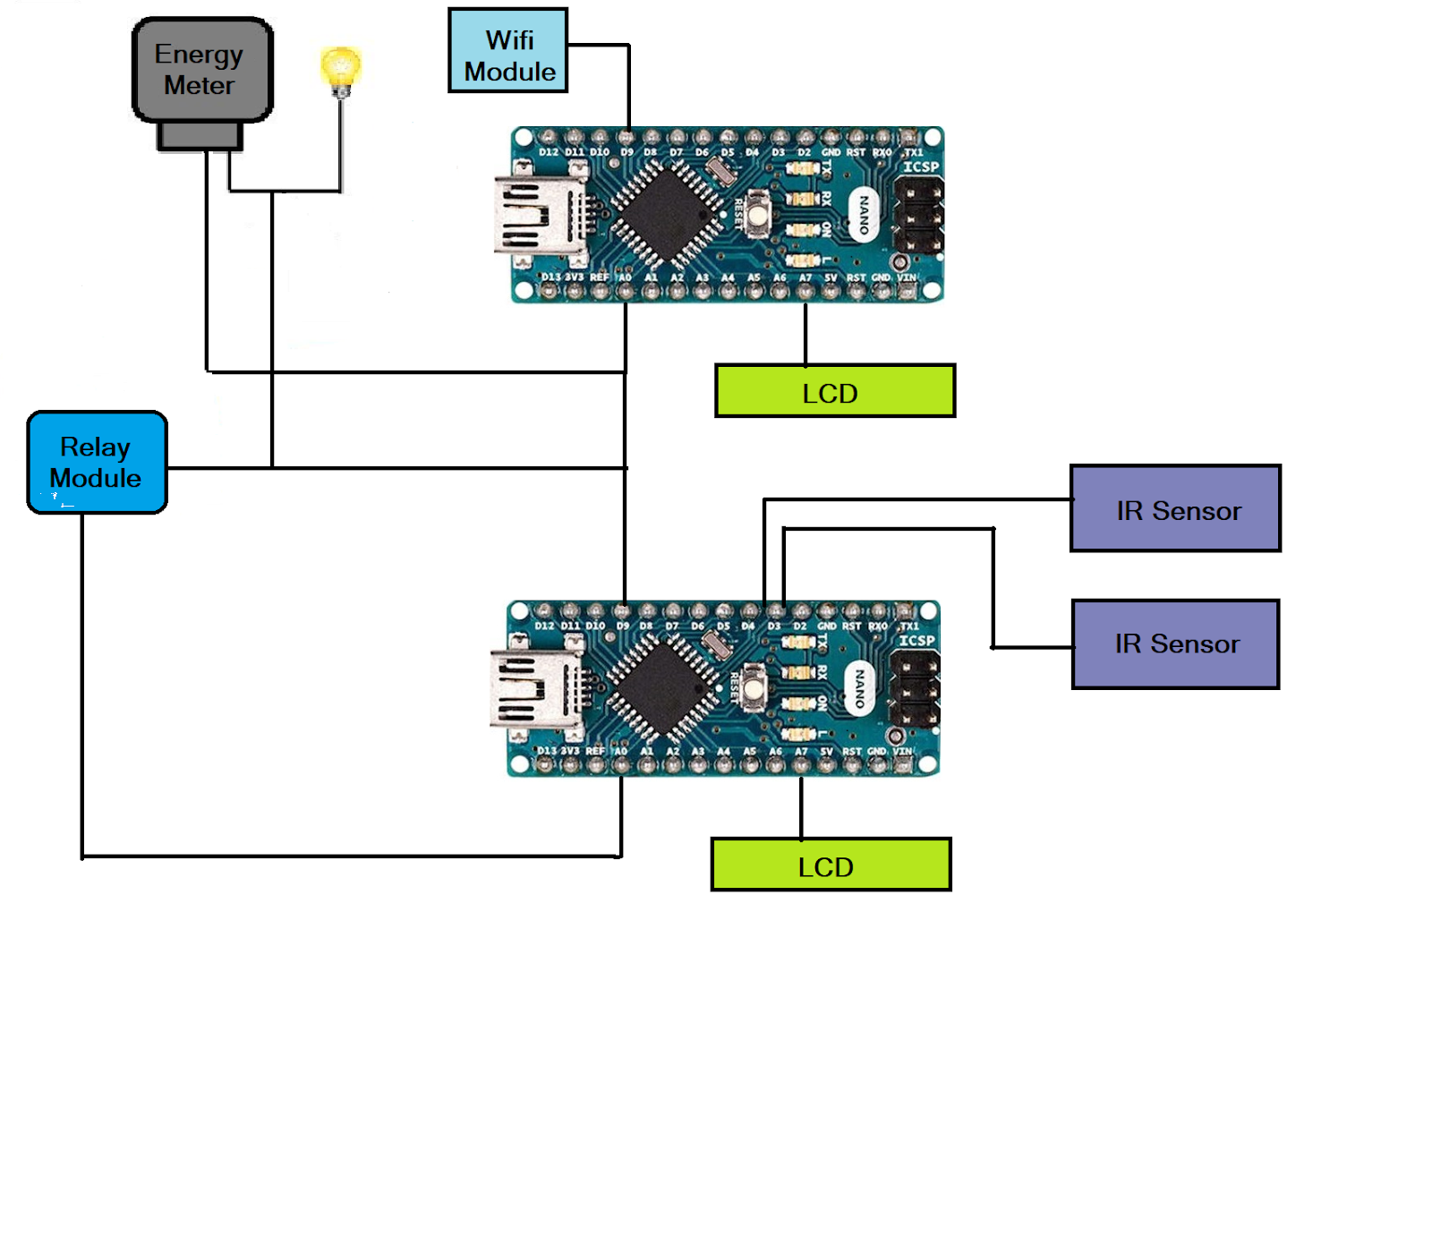
SYSTEM DESIGN
HARDWARE COMPONENT USED
ARDUINO UNO
LCD 16X2
LED
WI-FI MODULE ESP 8266
ENERGY METER
ELECTRIC BULB
IR SENSORS
Block Diagram of the Model

Slide 9
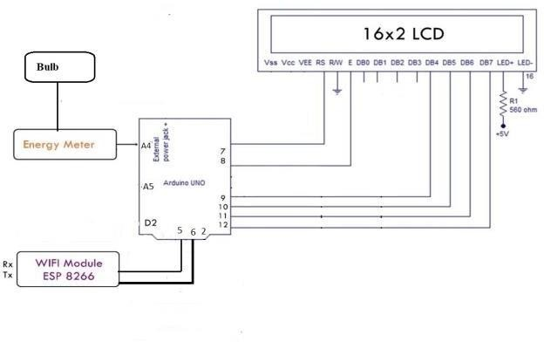
CONTINUE
An energy meter is connected with LED and resistance of 1 𝑘 𝛺 which is used for counting the energy consumed by the bulb and LCD is used for displaying the data and through the wi-fi module present in the circuit.
Circuit Diagram of the Model Of Energy Monitoring System

Slide 10
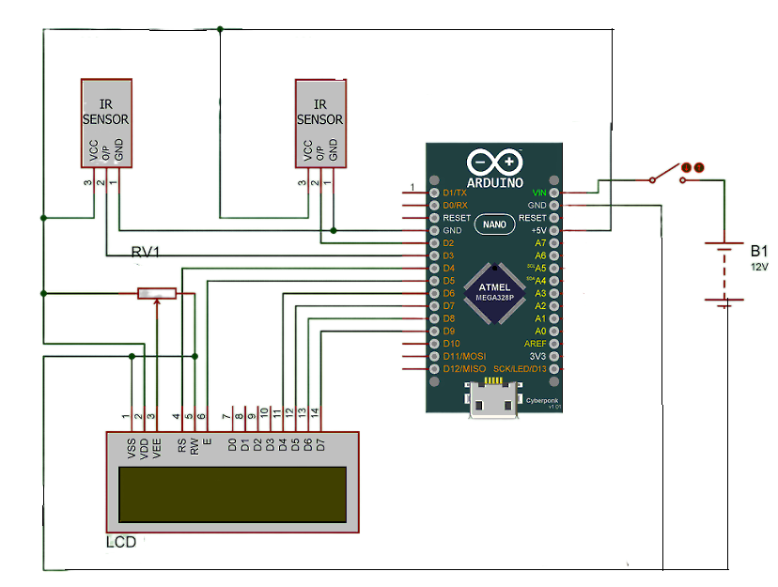
CONTINUE
The purpose of this circuit is to provide a seamless and automated solution for managing visitors in a space, such as a room or a building, by turning on and off a light based on the presence of visitors.
Circuit Diagram of IR Sensors

Slide 11
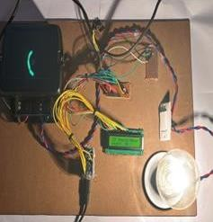
CONTINUE
The present approach to analyzing energy use at the domestic level is being improved by this model. The present energy meters have a number of issues, including the requirement for routine inspection and adjusting as well as two-way contact, among others. This initiative seeks to cut down on energy consumption and keep track of wasted units to address these problems.
Prototype of Model with load of 200W

Slide 12
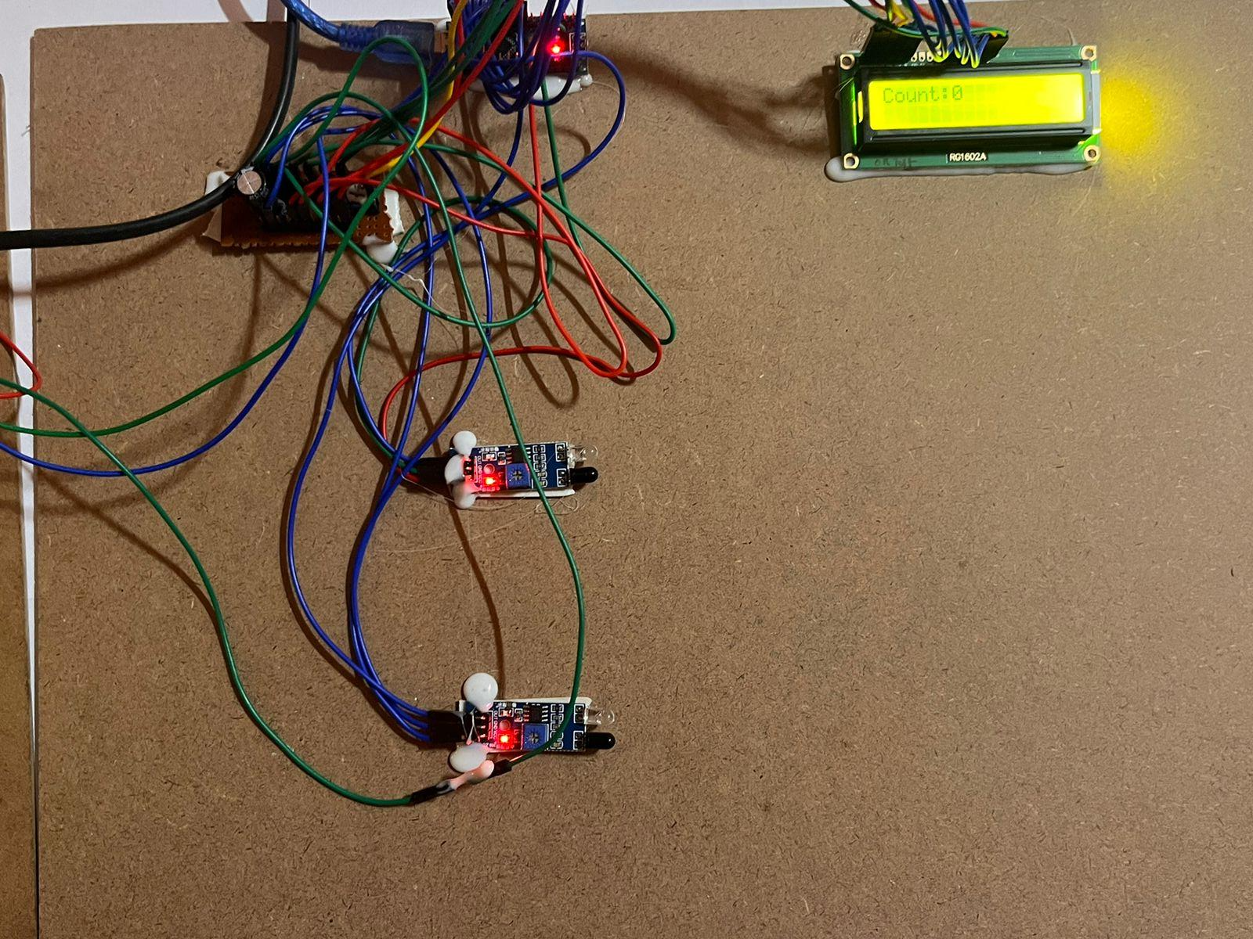
CONTINUE
The IR sensor monitors visitor count by detecting their presence in the room. When the visitor count is one, the microcontroller activates the relay module to turn on the bulb, and when there is no visitor, it turns off the bulb.
Prototype of Visitor Count

Slide 13
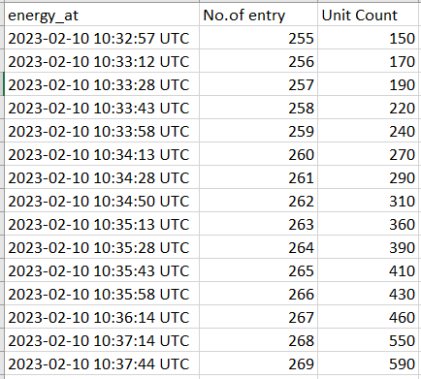
RESULTS
The Results from the Excel shows the real date and time, the total number of entries and the unit count.
Real-Time data in Tabular Form

Slide 14
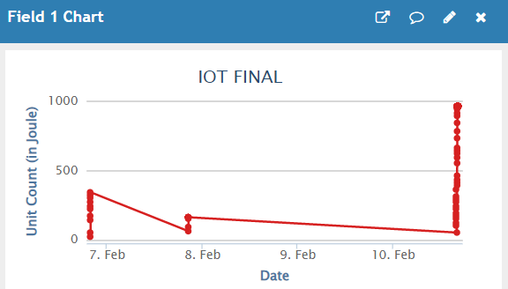
CONTINUE
The results of the energy consumption data in the form of graphs which shows the energy usage patterns over a period of time, such as hourly, daily, weekly, or monthly, and highlight the peak usage periods.
Graph of Date Vs Unit count

Slide 15
CONCLUSION
The project utilizes an Arduino Nano microcontroller, which serves as the brain of the system, to interface with various components and collect data. The LCD display is used to showcase the electricity consumption in units, allowing users to monitor their usage and make informed decisions about their energy consumption habits. The WiFi module is integrated into the system, enabling data to be uploaded to ThingSpeak, an IoT platform, for further analysis and visualization. The project has several potential benefits. First, it promotes energy conservation by providing real-time monitoring and display of electricity usage, helping users to be more conscious of their energy consumption habits and make informed decisions to reduce their carbon footprint. Second, the visitor counting system helps optimize lighting usage, ensuring that lights are only turned on when needed, which can lead to significant energy savings.

Slide 16
REFERENCES
Kothandaraman, D., A. Harshavardhan, V. Manoj kumar, D. Sunitha, and seena naik korra. "BLE in iot: improved link stability and energy conservation using fuzzy approach for smart homes automation." Materials today: proceedings (2021).
Morello, rosario, subhas c. Mukhopadhyay, zheng liu, daniel slomovitz, and subhransu ranjan samantaray. "Advances on sensing technologies for smart cities and power grids: A review." IEEE sensors journal 17, no. 23 (2017): 7596-7610.
Khan, md minhaz, sm zahid hasan sakil, muhammad ahad rahman miah, md shohel rana, and shaikh rashedur rahman. "Sustainable building energy conservation and efficiency management using iot." In 2022 international conference on electronics and renewable systems (ICEARS), pp. 518-524. Ieee, 2022.
Rahman, M.M., Islam, M.O. and Salakin, M.S., 2015, May. Arduino and GSM based smart energy meter for advanced metering and billing system. In 2015 International Conference on Electrical Engineering and Information Communication Technology (ICEEICT) (pp. 1-6). IEEE.
Tomar, G.S., Chaudhari, N.S., Barbosa, J.L.V. and Aghwariya, M.K. eds., 2020. International conference on intelligent computing and smart communication 2019: Proceedings of ICSC 2019. Springer Nature.
Metering, A.S., Visalatchi, S. and Sandeep, K.K., 2017, April. Smart energy metering and power theft control using arduino & GSM. In 2017 2nd international conference for convergence in technology (I2CT) (pp. 858-961). IEEE.

Slide 17
GitHub Link
https://github.com/NikitaSinha07/EnergyConservation

Slide 18
THANK YOU !!!!

